Slide 1
Behavioral Driven Development
https://dzone.com/articles/guide-to-behavior-driven-development-in-java

Slide 2
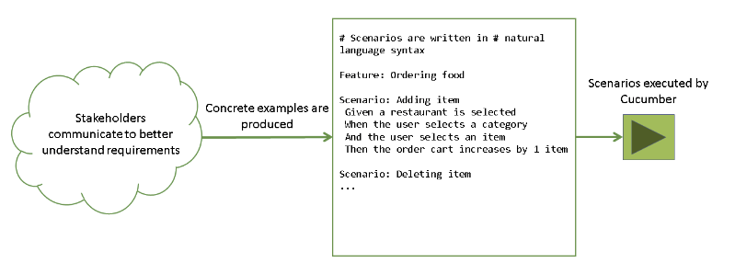
Introduction
Build on the main ideas of test driven development
Instead of unit test for classes and methods the text are acceptance tests
  Better Collaboration between developers and business
  Derived from concrete examples
  validate the behavior of the application test
    The requirements are to be expressed more clearly
    The input of the developer will likely be incorporated
    The test will contribute more scenarios
Easy to read by non developers
Gherkin Syntax – A syntax so diff BDD tools can read the code : https://cucumber.io/docs/gherkin/reference/
Terminology
  executable specification for the behavior of a feature under test
  Specification can be executed as automated regression test
  The scenario act as documentation about the featuers and follows the main code veriosn

